Slide 1
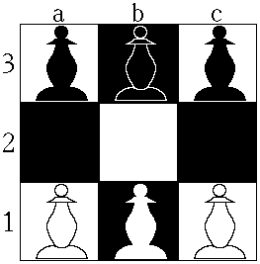
Hexapawn
BY:
Hruthwik k (1BM17IS032)

Slide 2
Problem statement
Hexapawn is a deterministic two-player game and played on a 3×3 board.
Each pawn may be moved in two different ways: it may be moved one square forward, or it may capture a pawn one square diagonally ahead of it.
A pawn may not be moved forward if there is a pawn in the next square.
A player loses if he/she has no legal moves or the other player reaches the end of the board with a pawn.
The goal of each player is to advance one of their pawns to the opposite end of the board or to prevent the other player from moving.

Slide 3
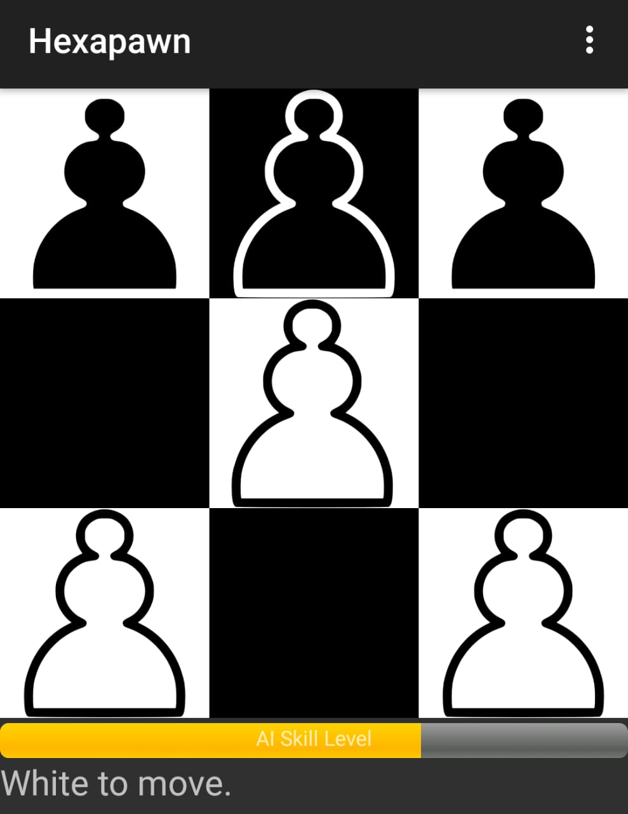
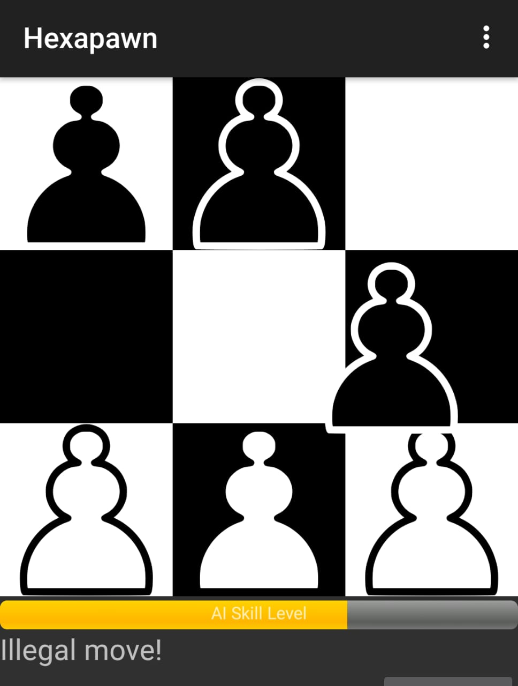
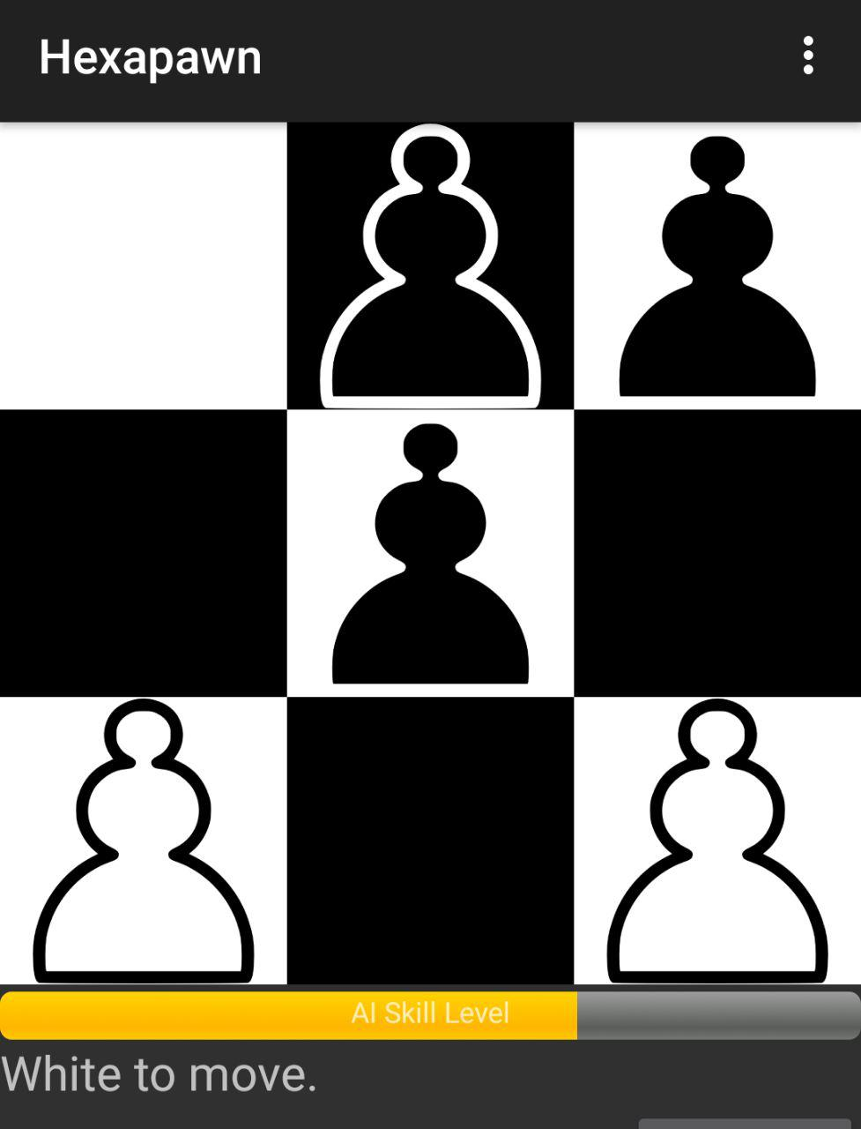
Case 1: valid moves/ invalid moves

Slide 4
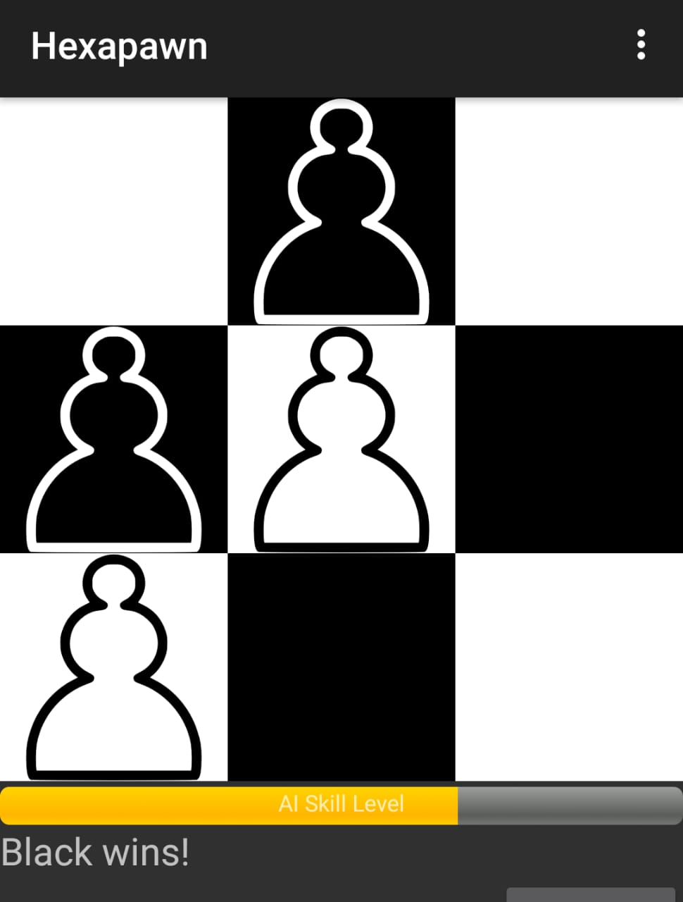
Case 2:No move condition

Slide 5
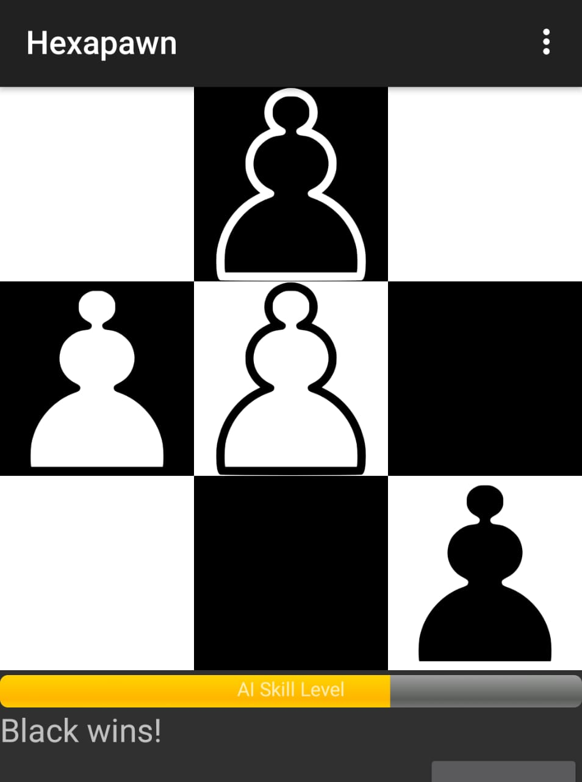
Case 3: reaching the end

Slide 6
LOGIC APPLIED
A 2-D array is used to store the place of the pawns.
All the empty boxes in the board are set to zero.
As the move is updated previous location is set to zero.
Winning condition of the pawn will be checked using it’s i value.(i.e reaching the opposite end).
Blocking condition is checked after every move.

Slide 7

THANK YOU

